Slide 1




Linux - introduction
https://hpcleuven.github.io/Linux-intro/
Mag Selwa
ICTS Leuven
3 October 2019

Slide 2
Overview
Introduction – Linux philosophy
Command line basics – getting help
Navigating the file system
The shell revisited: some features
File manipulation
Text editing
Groups, users, security
Process control

Slide 3
Remark
Commands will be displayed with different font and will start always with prompt sign ($) – which is already included in the command line

Slide 4
Introduction

Slide 5
Purpose
Get a grip on the very basics: an introduction to the (basic) Linux commands as normally used for computational research (e.g. HPC cluster)
Focus on using the command line
Short hands-on examples

Slide 6
Information
Most of the presentation is based on the information found in:
http://dontfearthecommandline.blogspot.com/
Nicholas Marsh
Introduction to the Command Line (Second Edition)
http://linuxcommand.org/tlcl.php
William Shotts
The Linux Command Line
http://www.oreilly.com/programming/free/ten-steps-to-linux-survival.csp?download=yes&order=1274753
James Lehmer
Ten Steps to Linux Survival
https://bootlin.com/doc/legacy/command-line/unix_linux_introduction.pdf
Michael Opdenacker & Thomas Petazzoni
The Unix and GNU/Linux command line

Slide 7
Websites?
http://www.howtogeek.com/tag/linux/
Includes help, tutorials, tips and how-to guides for Linux.
http://www.tldp.org
The Linux Documentation Project
http://www.lwn.net
Linux Weekly News:Covering the Linux and free software communities since 1998.
http://www.linuxjournal.com
The monthly magazine of the Linux community, promoting the use of Linux worldwide.

Slide 8
Try it?
Install virtual machine software
Vmware player
http://www.vmware.com/products/player/
Virtualbox
https://www.virtualbox.org/
Install a linux distribution
Ubuntu http://www.ubuntu.com/
CentOS https://www.centos.org/
Opensuse http://www.opensuse.org/
…

Slide 9

Knoppix can be a good solution
You do not need to install Knoppix on harddisk
So it can be used in Demo of linux or software on Linux,
So you need extra Linux machine lab in a few minutes,
No extra space on harddisk on old PC's, just use Knoppix,
Got a new laptop, just boot Linux on it.

Slide 10
Windows and Linux
Both Linux and Windows are based on foundations developed in the mid-1970s
Both DOS, MAC and UNIX are proprietary, i.e., the source code of their kernel is protected
No modification is possible without paying high license fees
1970
1980
1990
2000
v2.0
v2.1
v2.2
v2.3
UNIX public
UNIX V6
Linux v1.0
v2.4
v2.6
UNIX born
1970
1980
1990
2000
VMS v1.0
NT 4.0
Server 2003
Windows XP
Windows NT 3.1
Windows 2000

Slide 11

Some history
GNU project:
Established in 1984 by Richard Stallman (goal: software should be free from restrictions against copying or modification in order to make better and efficient computer programs),
GNU is a recursive acronym for “GNU's Not Unix”,
Aim at developing a complete Unix-like operating system which is free for copying and modification,
Companies make their money by maintaining and distributing the software, e.g. optimally packaging the software with different tools,
Stallman built the first free GNU C Compiler in 1991. But still, an OS was yet to be developed

Slide 12
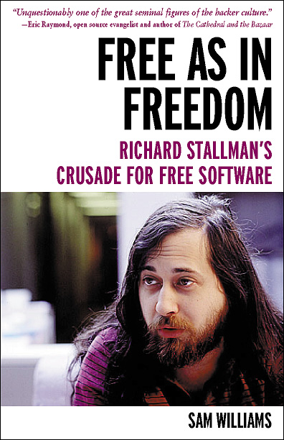

Open Source Software
Open Source Software (OSS) generally refers to software for which the source code is available and which the licensing scheme permits the user to modify it and redistribute it in modified or unmodified form.
GNU copyleft (www.gnu.org)
Nobody should be restricted by the software they use. There are four freedoms that every user should have:
the freedom to use the software for any purpose,
the freedom to change the software to suit your needs,
the freedom to share the software with your friends and neighbors, and
the freedom to share the changes you make.
When a program offers users all of these freedoms, we call it free software.

Slide 13

Linux: some history
UNIX: roots in Bell Labs (AT&T)
1985 Free Software Foundation (FSF) founded by Richard Stallman. Along with other programmers creates the tools needed to make a UNIX compatible OS
1985 Professor Andy Tannenbaum creates a UNIX like operating system based on System V Unix for the IBM PC & PC/AT computers. It is called Minix.
1989 Richard Stallman releases GPL and GNU software but lacks a free kernel.
1991 Building on the concepts in Minix, Linus Torvalds (Finnish college student) develops Linux along with help from other users on the web.

Slide 14
Operating system?
Strictly speaking Linux refers to the kernel
GNU/Linux more accurately describes the Operating System. Linux Kernel combined with GNU utilities and libraries
Distribution – GNU/Linux bundled with other applications. Examples Red Hat Linux, Debian, Ubuntu, Suse, Knoppix, etc.
Distributions can be compiled and maintained by an individual or corporation. Can be small (single floppy disk) or span several CD/DVDs.
www.distrowatch.com for more information

Slide 15
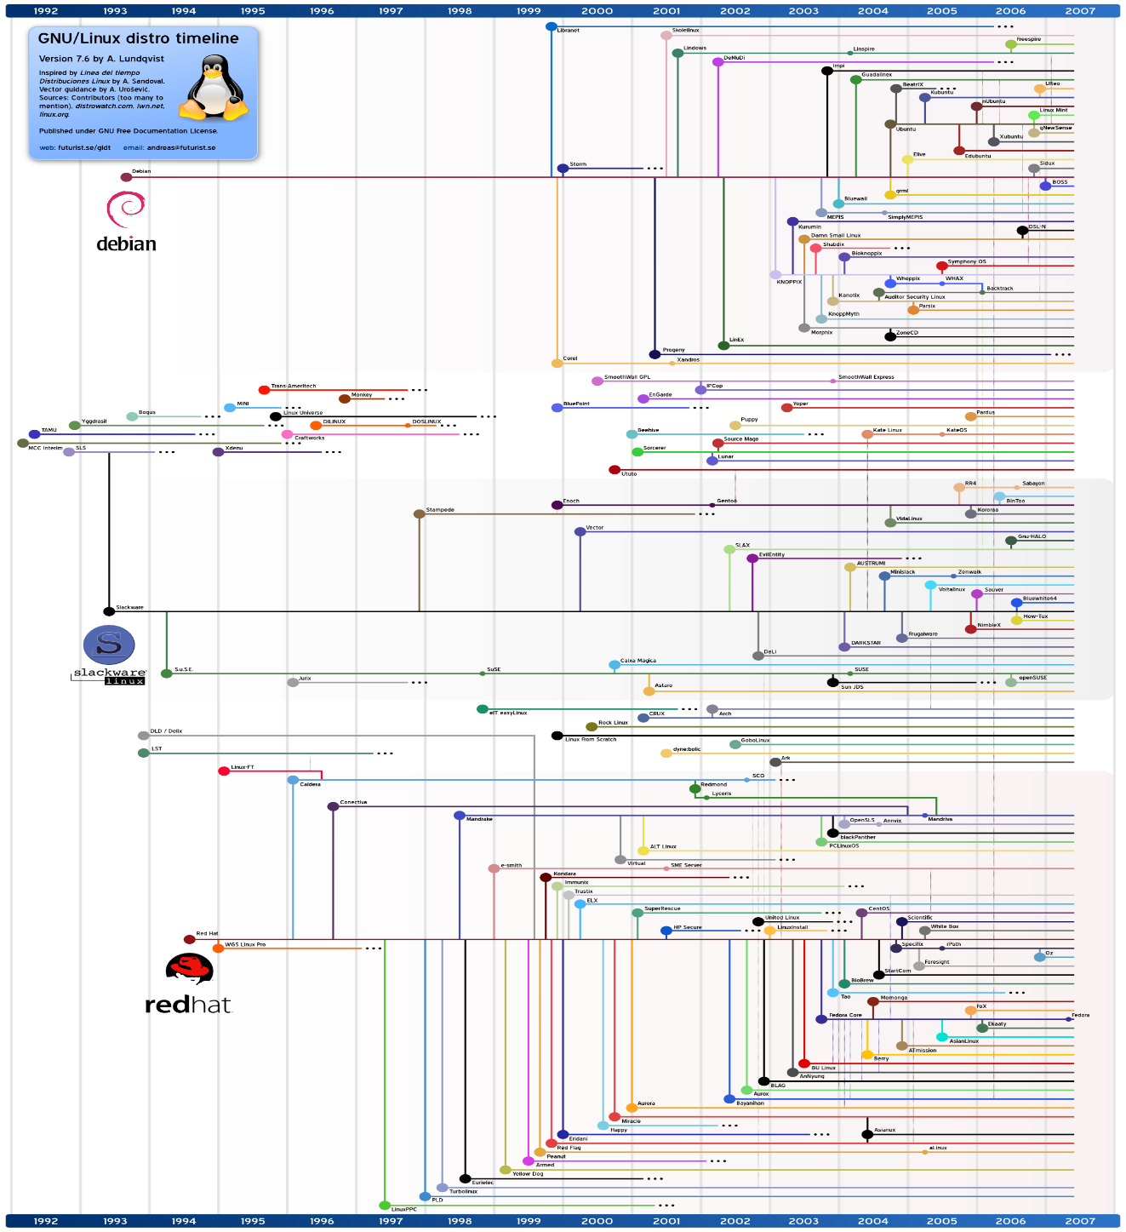
Which Linux Distribution is better?
Source: http://futurist.se/gldt/
Ubuntu
Debian
Debian
Knoppix
Slackware
Slackware
Gentoo
CentOS
CentOS
Redhat
Redhat
Red Hat (Enterprise) Linux is the largest commercial Linux vendor. Focus on stability and long term support.
http://www.cs.ucr.edu/~weesan/cs183/

Slide 16
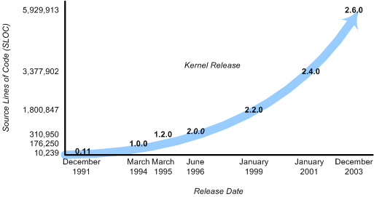
Linux Kernel
aka: executive, system monitor.
The kernel provides a layer between the computer hardware and user applications.
Provides an interface for software to use hardware (no direct access)
Planning and assigning:
memory, CPU, disk, etc.
security aspects
Fulfill user requests (system calls).
Filesystem, networking, ...

Slide 17
Applications: Compilers, word processors, X-based GUI
Linux OS
AUI
LINUX Shell: Bourne Again (bash), TC, Z, etc.
Language libraries
API
System call interface
Memory management
File management
Process Management
Kernel
Device Drives
BIOS
Computer Hardware
Kernel
The part of an OS where the real work is done
System call interface
Comprises a set of functions (often known as Application Programmer's Interface API) that can be used by the applications and library routines to use the services provided by the kernel
Application User’s Interface
Interface between the kernel and user
Allows user to make commands to the system
Divided into text based and graphical based

Slide 18
Linux Kernel
File Management
Controls the creation, removal of files and provide directory maintenance
For a multiuser system, every user should have its own right to access files and directories
Process Management
For a multitask system, multiple programs can be executed simultaneously in the system
When a program starts to execute, it becomes a process
The same program executing at two different times will become two different processes
Kernel manages processes in terms of creating, suspending, and terminating them
A process is protected from other processes and can communicate with the others

Slide 19
Linux Kernel
Memory management
Memory in a computer is divided into main memory (RAM) and secondary storage (usually refer to hard disk)
Memory is small in capacity but fast in speed, and hard disk is vice versa
Data that are not currently used should be saved to hard disk first, while data that are urgently needed should be retrieved and stored in RAM
Device drivers
Interfaces between the kernel and the BIOS
Different device has different driver

Slide 20
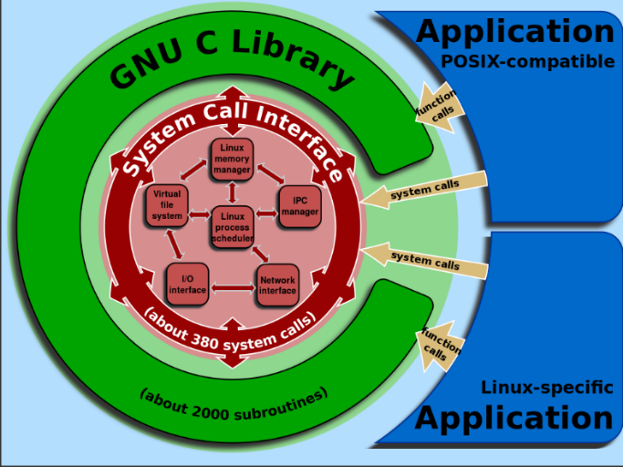
Compatibility Statement
Source: http://en.wikipedia.org/wiki/GNU_C_Library
Definition of the OS version
Kernel version (i.e. kernel 2.2.12)
glibc version (i.e. glibc 2.1.2)
Determining the OS Version
Kernel version ($ uname –r -> 2.2.14)
System distribution ($ uname –a)
glibc version ($ ls -l /lib(64)/libc.so* -> libc-2.1.2.so (Red Hat)
glibc version ($ ls -l /lib/i386-linux-gnu/libc.so* -> libc-2.1.2.so (Debian 32-bit)
glibc version ($ ls -l /lib/x86_64-linux-gnu/libc.so* -> libc-2.1.2.so (Debian 64-bit)
$ rpm -qa | grep libc -> glibc-2.1.2-11)
$ ldd –version
Determining the OS Flavor/release
$ cat /etc/*-release

Slide 21
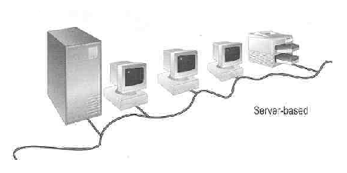
User login
Linux is a multiuser OS ,
Allows multiple users to use the resource of a computer at the same time
Every user needs to login the system with the password provided to identify their right in using the resource
Requires for both client-server based system or desktop
Linux Server

Slide 22
Linux User Interface
Traditional Linux (Unix also) uses command-driven interface (or text-based interface)
User needs to type lines of command to instruct the computer to work, similar to DOS
Advantage: fast in speed. Very few resource is required for its implementation
Disadvantages: user needs to type, hence can easily make error. Besides, user needs to memorize all commands
Suitable for expert users and for the systems that interaction with user is not frequent, such as servers

Slide 23
Linux User Interface
By adopting the X-Window technology, graphical user interface (GUI) is available for Linux:
Uses pointing devices (e.g. mouse) to control the system, similar to Microsoft’s Windows
Provide menu-driven and/or icon-driven interfaces
menu-driven: user is provided with a menu of choices. Each choice refers to a particular task
icon-driven: tasks are represented by pictures (icon) and shown to user. Click on an icon invokes one task
Advantages: No need to memorize commands. Always select task from menus or icons
Disadvantages: Slow and require certain resource for its implementation
Suitable for general users and systems, such as PC

Slide 24
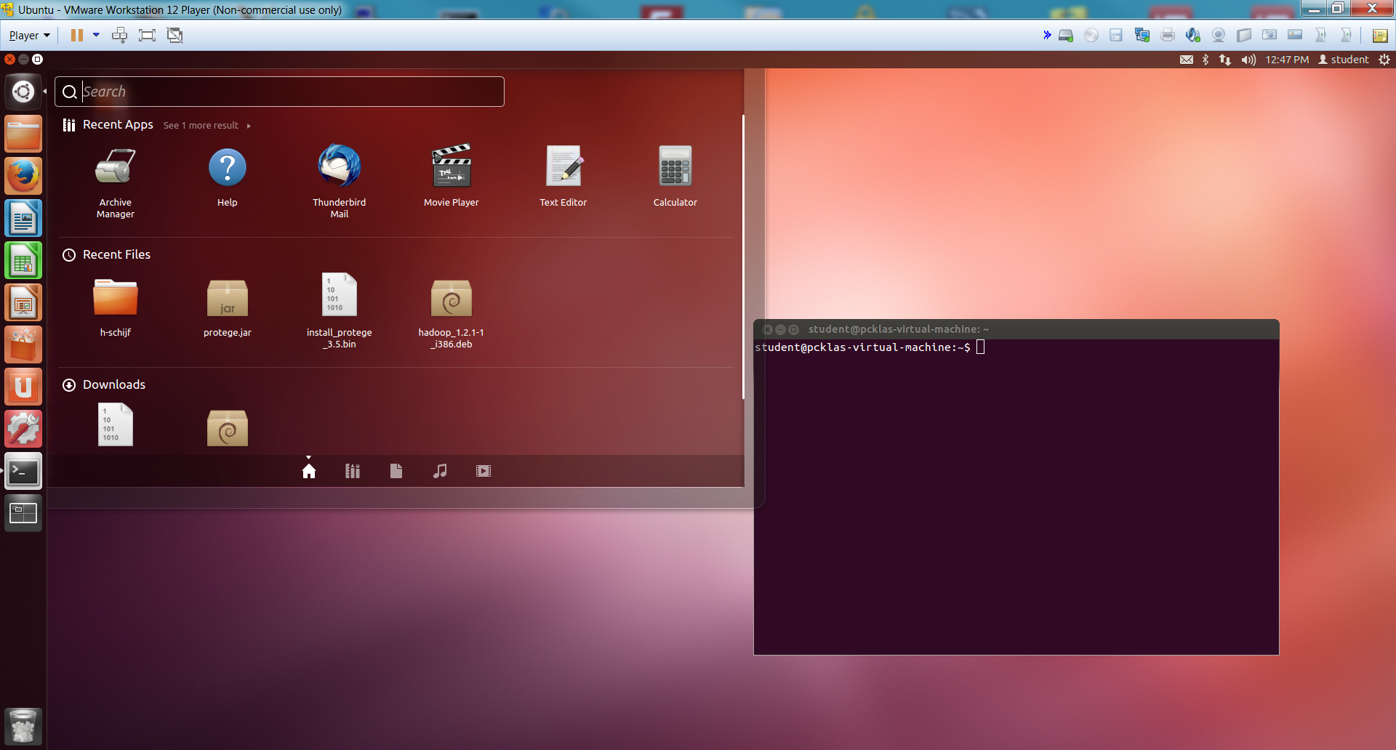
Linux User Interface

Slide 25
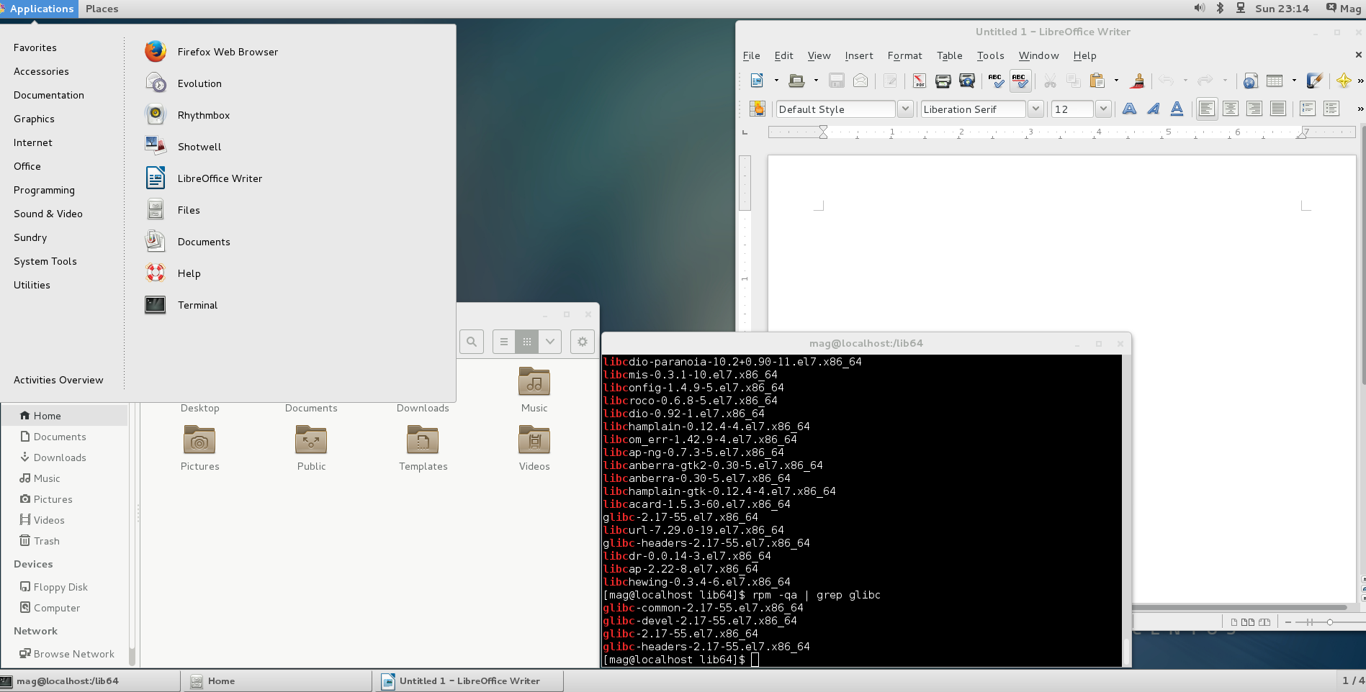
Linux User Interface

Slide 26
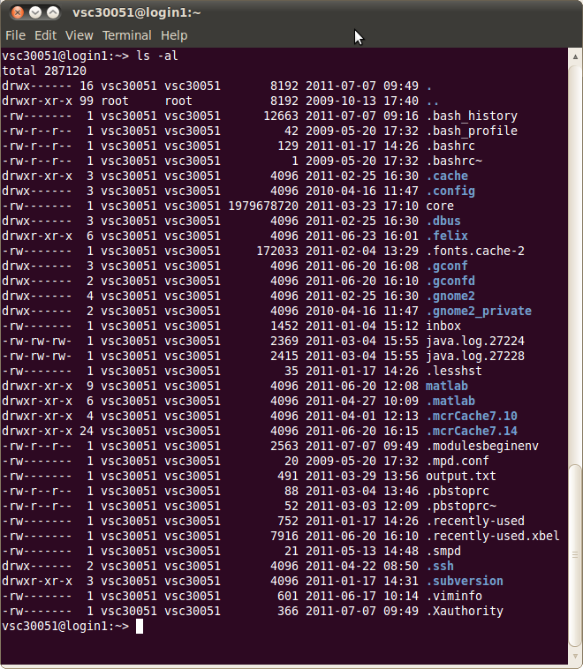
Command Line
Text mode
Provides a way to control the computer via the keyboard.
Is common use on HPC
Is somewhat archaic, but very powerful.
Can be much quicker than a GUI.
Implicitly assumes that you know what your are doing
Don't be scared!
If anything goes wrong, you can stop the command with Ctrl+C

Slide 27
Linux text based interface: The shell
Is the command line interpreter: a program that accepts input from a user (e.g. a command) and performs the requested task.
The shell's prompt identifies the type of shell being used. There are two basic types of shell prompts:
$ Normal user shell (may also be % or > on some systems)
# Root user shell (login as root or $ su)
!!! Warning: The root user can do anything on Linux systems. It is important to know when you are working as root to prevent accidental damage to your system.
The way to identify the user: $ whoami

Slide 28
Using the root account
If you have the root password: $ su - (switch user)
In modern distributions, the sudo command gives you access to some root privileges with your own user password. Example: $ sudo mount /dev/hda4 /home
root user privileges are only needed for very specific tasks with security risks: mounting, creating device files, loading drivers, starting networking, changing file ownership, package upgrades...
Check the prompt #

Slide 29
Most popular shells
There are several types of shells for Linux.
Check it with $ echo $SHELL
Shell | Prompt | Name | Note
sh | $ | Bourne Shell | Default on some Unix systems
bash | $ | Bourne Again Shell | Enhanced replacement for the Bourne shell Default on most Linux and Mac OS X systems
csh | % | C Shell | Default on many BSD systems
tcsh | > | TC Shell | Enhanced replacement for the C shell
ksh | $ | Korn Shell | Default on AIX systems

Slide 30
Hands-on 1

Slide 31

Vmware in pc-klas

Slide 32
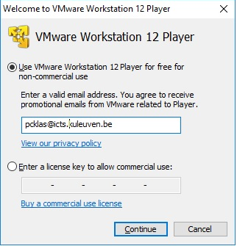
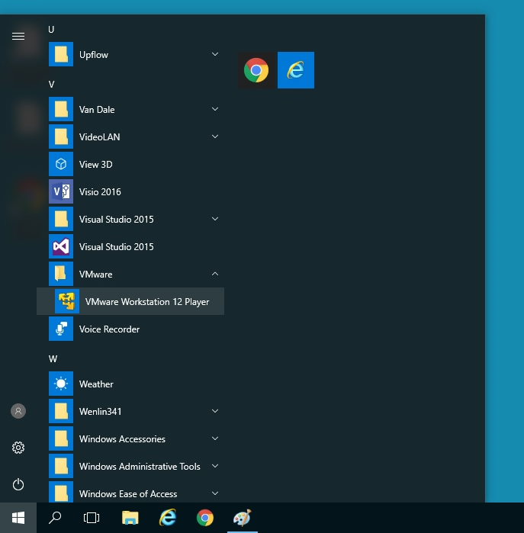
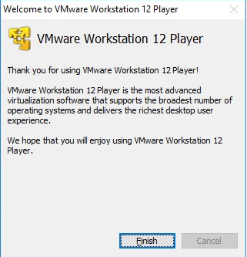
Vmware in pc-klas

Slide 33
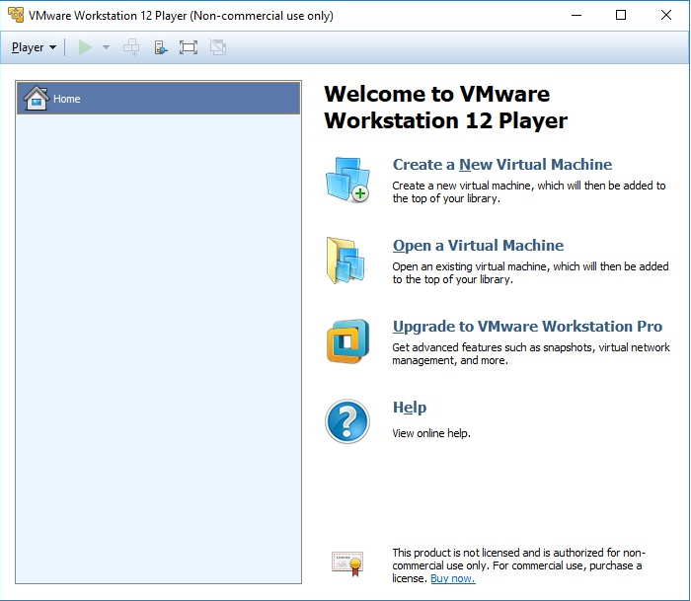
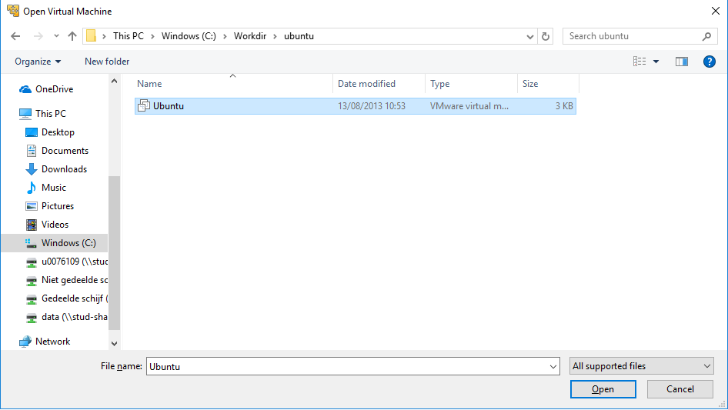
Vmware in pc-klas

Slide 34
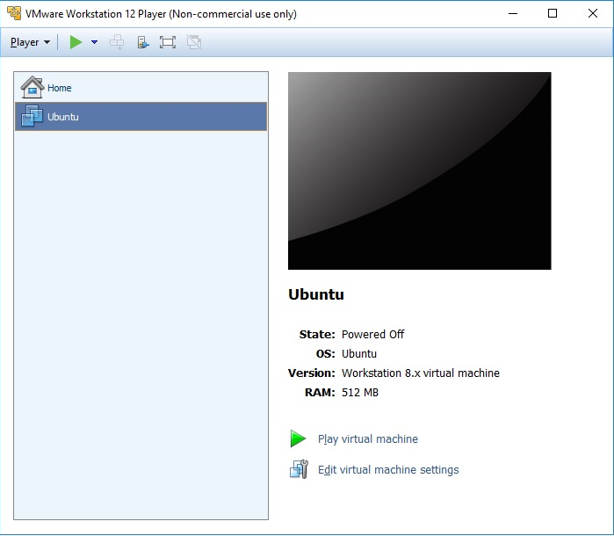
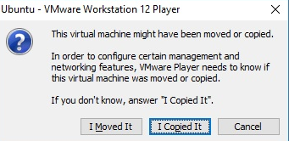
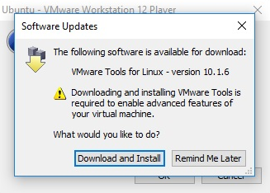
Vmware in pc-klas

Slide 35
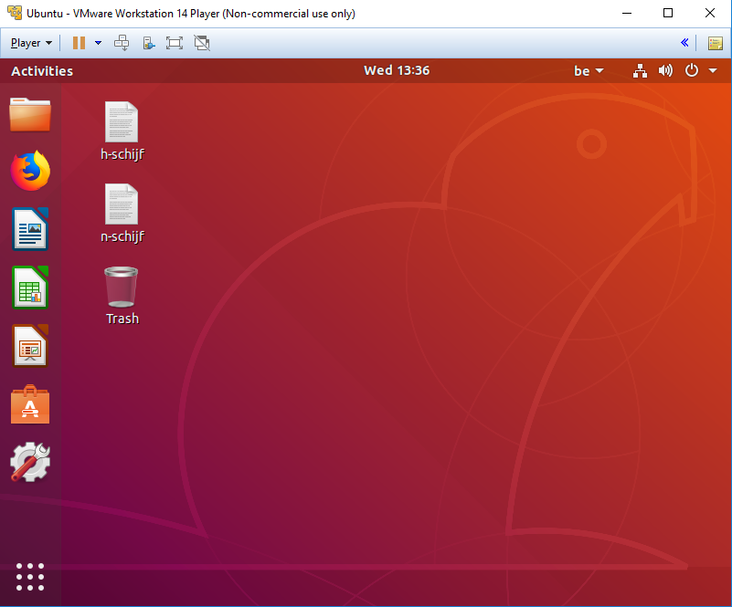
Vmware in pc-klas

Slide 36
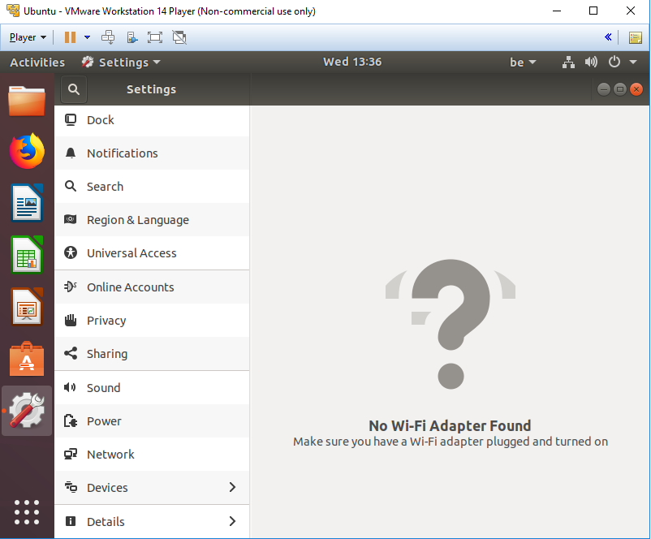
Vmware in pc-klas

Slide 37
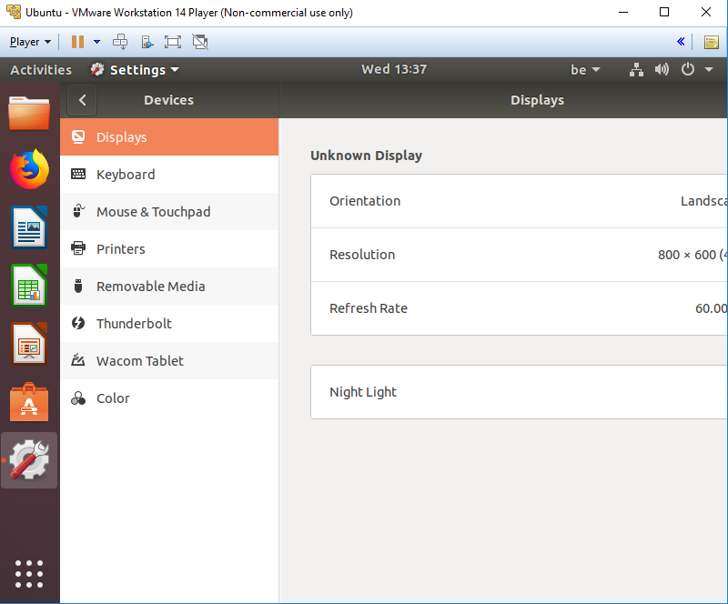
Vmware in pc-klas

Slide 38
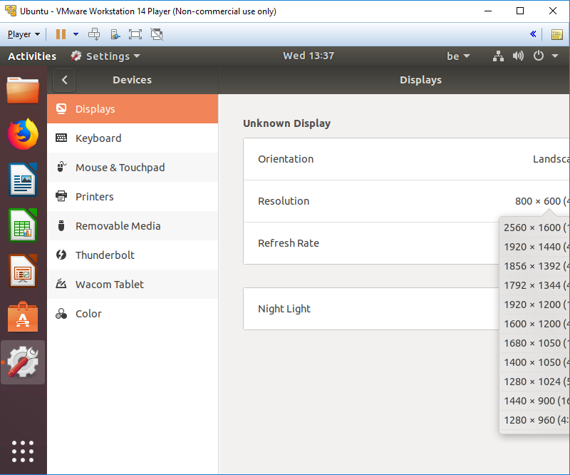
Vmware in pc-klas

Slide 39
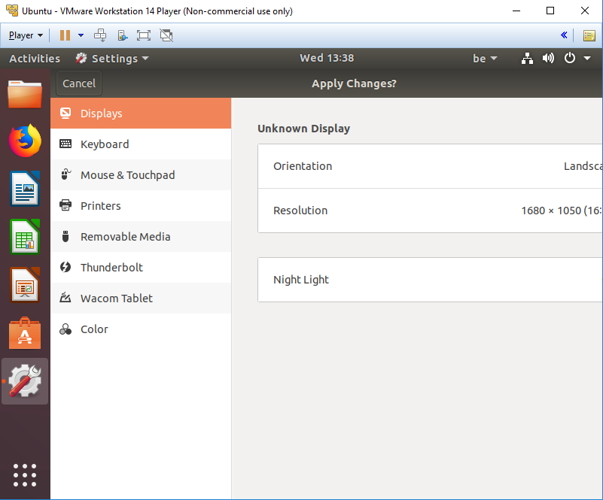
Vmware in pc-klas

Slide 40
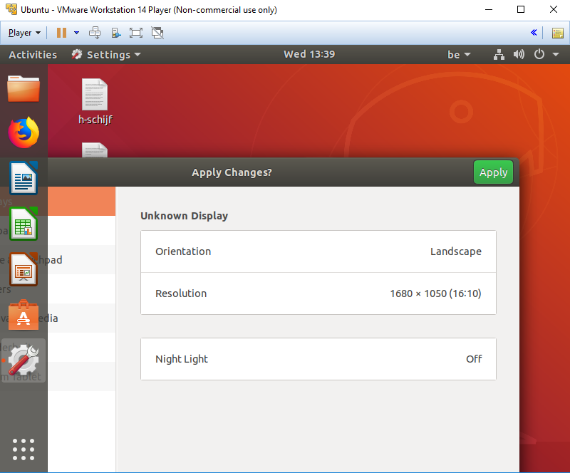
Vmware in pc-klas

Slide 41
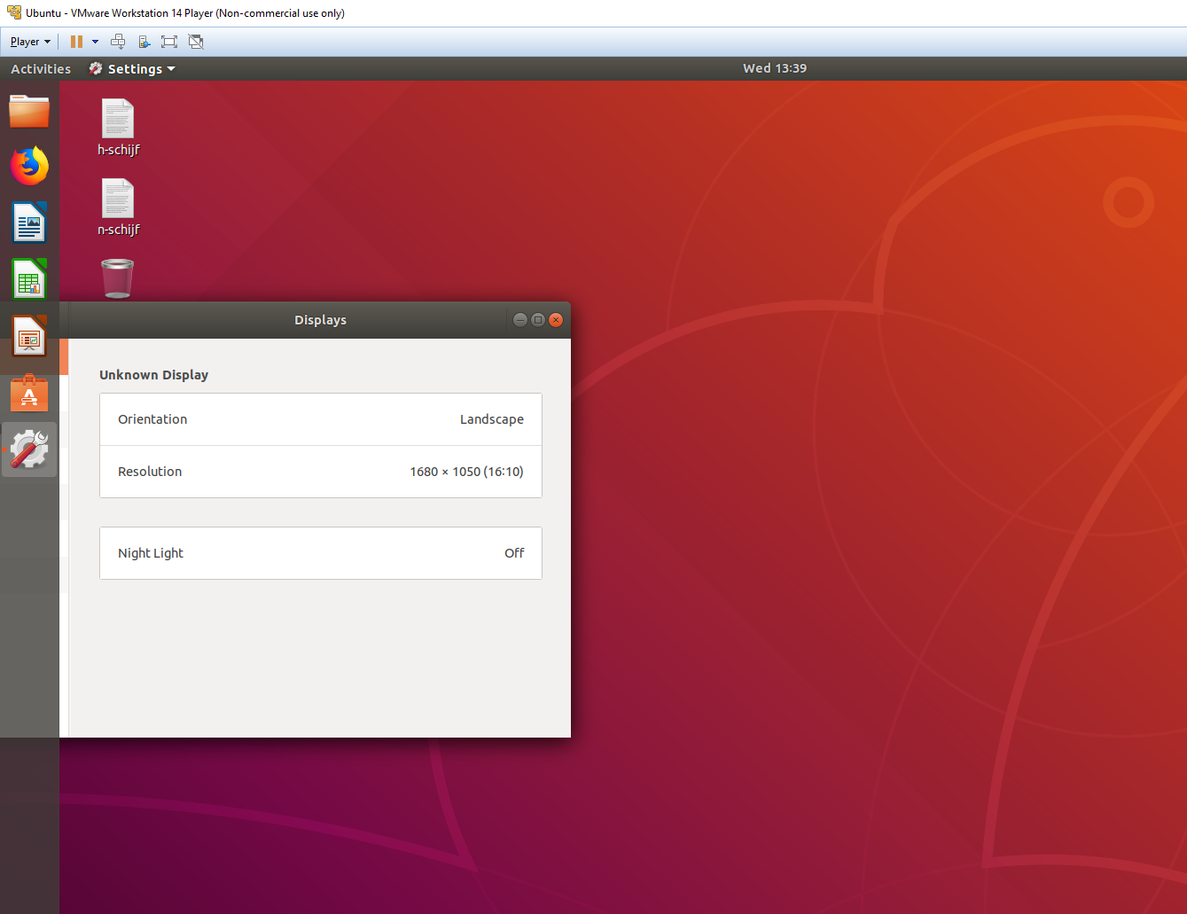
Vmware in pc-klas

Slide 42

Vmware in pc-klas

Slide 43
Command line basics Getting Help

Slide 44
Important rules on the command line
Linux systems are case (and space) sensitive.
MyFile is not same as myfile
There is no "recycle bin" or "trash can" when working in the command line environment. There might be one for GUI. When files are deleted on the command line, they instantly disappear forever.
You should always practice new commands on a test system that is not used in a production environment. This minimizes the chances of an accident that can take down an important system

Slide 45
Important rules on the command line
“\” vs. “/”:
In Linux, the “/” is the directory separator, and the “\” is an escape character.
In Windows, the forward-slash “/” is the command argument delimiter, while the backslash “\” is a directory separator
Filenames:
In Linux, there is no such thing as a file extension. Periods can be placed at any part of the filename, and “extensions” may be interpreted differently by all programs, or not at all.
Windows uses the “.extension” filename convention, (e.g. FILENAME.TXT).

Slide 46
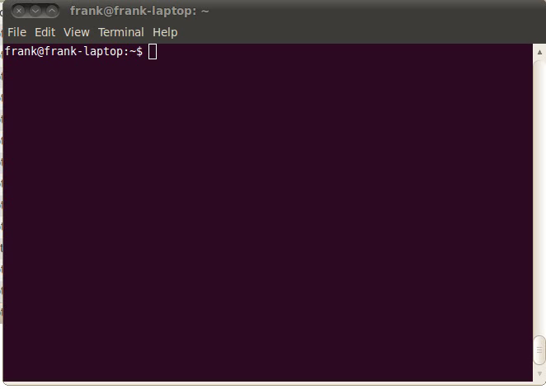
Getting help: command built-in
Help on most Linux commands is typically built into the command themself
These flags usually look like “-h” or “--help”.
$ ls --help

Slide 47
Getting help: man pages
Best source of information can be found in the online manual pages, “man pages” for short. type “man command”.
$ man grep
Tips:
To search for a particular word (e.g. file) within a man page, type “/word”.
To quit from a man page, type the “q” key.
If you do not remember the name of Linux command and you know a keyword relating to the command, search the man pages with the –k $ man -k control

Slide 48
Getting help: info pages
Info pages are similar to man page, but instead of being displayed on one long scrolling screen, they are presented in shorter segments with links to other pieces of information.
Access with the “info” command $ info ls
Tips:
To quit from a info page, type the “q” key.
Type “h” to get more help on the info

Slide 49
Getting help
bash has a built-in help facility available for each of the shell builtins. $ help cd $ help pwd
whatis displays a very brief description of a command $ whatis pwd

Slide 50
Useful commands
Clear the contents of the current screen $ clear
$ logout
The logout command logs your account out of the system (in a text mode).
This will end your terminal session and return to the login screen.
Some systems may have a file called .logout or .bash_logout in each user's home directory.
$ exit
Exit the current shell. The exit command is similar to the logout command with the exception that it does not run the logout script located in the user's home directory.

Slide 51
Linux filesystem Navigating the filesystem

Slide 52
Linux File System
hierarchical directory structure: files are organized in a tree-like pattern of directories (folders), which may contain files and other directories, etc.
Everything is a file:
Regular files
Directories: files listing a set of files
Symbolic links: files referring to the name of another file
root /: the first directory in the file system.
Note: comparison with Windows,
Windows has a separate file system tree for each storage device (e.g. C-drive, D-drive, I-drive, …)
Linux has a single file system tree, regardless of how many drives or storage devices are attached to the computer. Storage devices are attached (or mounted) at various points on the tree.

Slide 53
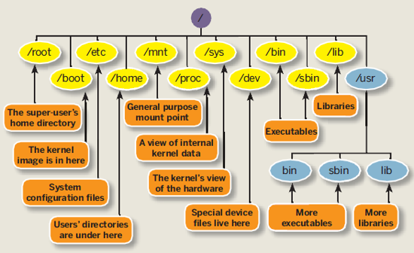
Linux File System
Source: http://linuxsuperuser07.blogspot.be/2011/09/rhel-6-file-system.html

Slide 54
Linux File System
Not imposed by the system. Can vary from one system to the other, even between two GNU/Linux installations!
/ Root directory /bin/ Basic, essential system commands /boot/ Kernel images, initrd, configuration files /dev/ Files representing devices /etc/ System configuration files /home/ User directories /lib/ Basic system shared libraries
/media/ Mount points for removable media

Slide 55
Linux File System
/lost+found/ Corrupt files the system tried to recover /mnt/ Mount points for temporarily mounted filesystems /opt/ Specific tools installed by the sysadmin /usr/local/ often used instead /proc/ Access to system information /sbin/ Administrator-only commands /sys/ System and device controls
/tmp/ Temporary files
The Unix filesystem structure is defined by the Filesystem Hierarchy Standard (FHS): http://www.pathname.com/fhs/pub/fhs-2.3.html
http://en.wikipedia.org/wiki/Filesystem_Hierarchy_Standard

Slide 56
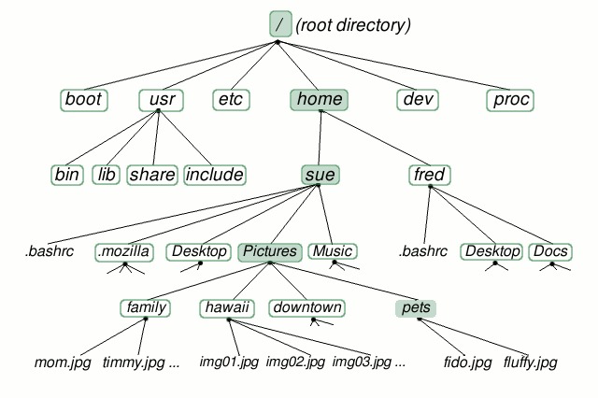
Linux File System-home directory
Source: http://www.linuxplanet.com/linuxplanet/tutorials/6666/1/screenshot3894/

Slide 57
ls command
Lists the files in the current directory, in alphanumeric order, except files starting with the “.” character.
$ ls -a (all) Lists all the files (including .* files)
$ ls -l (long) Long listing (type, date, size, owner, permissions)
$ ls -t (time) Lists the most recent files first
$ ls -S (size) Lists the biggest files first
$ ls -r (reverse) Reverses the sort order
$ ls -ltr (options can be combined) Long listing, most recent files at the end

Slide 58
ls command
$ ls *txt The shell first replaces *txt by all the file and directory names ending by txt (including .txt), except those starting with ., and then executes the ls command line.
$ ls -d .* Lists all the files and directories starting with . -d tells ls not to display the contents of directories. $ ls -d */
$ ls ?.log Lists all the files which names start by 1 character and end by .log
http://www.thegeekstuff.com/2009/07/linux-ls-command-examples/

Slide 59
ls command
vsc30051@login1:~/matlab/test> ls -al
total 1156
drwxr-xr-x 9 vsc30051 vsc30051 8192 2011-03-29 16:10 .
drwxr-xr-x 9 vsc30051 vsc30051 4096 2011-06-20 12:08 ..
drwxr-xr-x 3 vsc30051 vsc30051 4096 2010-01-08 10:54 courseAndreas
-rwxr--r-- 1 vsc30051 vsc30051 149326 2011-03-10 15:14 fibonacci
-rw-r--r-- 1 vsc30051 vsc30051 681 2011-03-10 15:09 fibonacci.m
-rwxr--r-- 1 vsc30051 vsc30051 149068 2011-03-10 12:16 ftest
-rw-r--r-- 1 vsc30051 vsc30051 443 2011-03-10 12:17 ftest_compiled.sh
-rw-r--r-- 1 vsc30051 vsc30051 442 2011-03-10 11:28 ftest_compiled.sh~
-rw-r--r-- 1 vsc30051 vsc30051 70 2011-03-10 12:15 ftest.m
In Linux, file is defined as simply the thing that deals with a sequence of bytes
Hence everything are files: an ordinary file is a file; a directory is also file; a network card, a hard disk, any device are also files since they deal with a sequence of bytes

Slide 60
Moving around
Symbolic (soft) link
Not a real file, just a link to another file
Allows giving another name to a file without actually duplicating it – hence saves memory space
Special file (device)
Each hardware device, e.g. keyboard, hard disk, CD-ROM, etc. is associated with at least one file
Usually store in /dev directory
Applications can read and write any devices by reading and writing their associate file – hence the access method is known as device independent
Divide into two types: character special files, e.g. keyboard, and block special files, e.g. disk

Slide 61
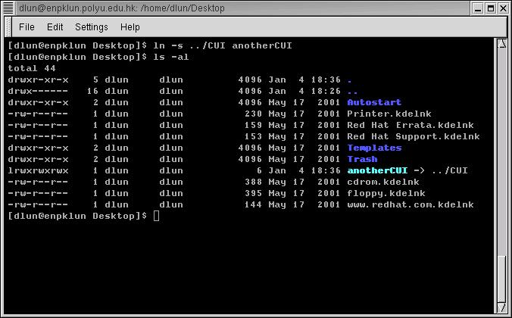
ls command
Command that sets a symbolic link to a file called CUI to anotherCUI
Names in blue are directories, indicated by a letter d at the beginning of the line
A symbolic link begins with a letter l

Slide 62
Moving around
Display the current/working directory
$ pwd
Print Working Directory
displays your current location within the file system.
Change (navigate) directories.
$ cd dir_name
Change Directories
changes the position to the specific directory
You can specify directory names in two ways:
Absolute pathname (starts from the root of the tree)
$ cd /u/home/hpc/test/bin
Relative pathname (relative to your current directory)
$ cd
$ cd .
$ cd ..
$ cd test/bin

Slide 63
Special directories
.
The current directory.
Useful for commands taking a directory argument.
Useful to run commands in the current directory
./readme.txt and readme.txt are equivalent.
..
The parent (enclosing) directory. Always belongs to the . Directory
Typical usage: cd ..
~
Shells just substitute it by the home directory of the current user.
-
cd – jump back to the previous directory

Slide 64
Linux File System - directories
cd .
Source: http://www.linuxplanet.com/linuxplanet/tutorials/6666/1/screenshot3894/

Slide 65
Linux File System - directories
cd ..
Source: http://www.linuxplanet.com/linuxplanet/tutorials/6666/1/screenshot3894/

Slide 66
Linux File System - directories
cd ../..
Source: http://www.linuxplanet.com/linuxplanet/tutorials/6666/1/screenshot3894/

Slide 67
Linux File System - directories
cd /
Source: http://www.linuxplanet.com/linuxplanet/tutorials/6666/1/screenshot3894/

Slide 68
Linux File System - directories
cd -
Source: http://www.linuxplanet.com/linuxplanet/tutorials/6666/1/screenshot3894/

Slide 69
Linux File System - directories
cd ~
Source: http://www.linuxplanet.com/linuxplanet/tutorials/6666/1/screenshot3894/

Slide 70
Linux File System-home directory
Relative path
cd ../Desktop
Source: http://www.linuxplanet.com/linuxplanet/tutorials/6666/1/screenshot3894/

Slide 71
Linux File System - directories
Relative path
cd ~/Desktop
Source: http://www.linuxplanet.com/linuxplanet/tutorials/6666/1/screenshot3894/

Slide 72
Linux File System - directories
Full path
cd /home/sue/Desktop
Source: http://www.linuxplanet.com/linuxplanet/tutorials/6666/1/screenshot3894/

Slide 73
File paths
A path is a sequence of nested directories with a file or directory at the end, separated by the / character
Relative path: documents/fun/file1 Relative to the current directory
To work with relative paths they need to have connection on the linux tree
Absolute path: /home/user/leuven/file2
/ : root directory. Start of absolute paths for all files on the system
Not a superuser’s home directory (-> /root)

Slide 74
More on files
What does a file contain?
Determine a file's type: file
will print a brief description of the file's contents
$ file filename
Search for files and directories
The find command performs a raw search on a file system to locate the specified items.
$ find location –name some-name
($ find /home/student -name *desktop)
Be careful: results can sometimes be slow
Search the locate database for files and directories
The locate command displays the location of files that match the specified name.
Faster than find because it searches a database of indexed filenames.
Disadvantage: lacks the ability to search for advanced characteristics such as file owner, size, and modification time.

Slide 75
More on files
Display extended information about a file system, file, or directory
The stat command displays extended information about files. It includes helpful information not available when using the ls command

Slide 76
File names
File name features:
Case sensitive
No obvious length limit (255 characters)
Can contain any character (including whitespace, except /).
File name extensions not needed and not interpreted. Just used for user convenience. (File types stored in the file)
a hidden file is any file that begins with a “.” (not seen with the bare ls
File name examples: README .bashrc index.htm index.html index.html.old

Slide 77
The Shell revisited: features

Slide 78
Auto-Completion
Have the shell automatically complete commands or file paths.
Activated using the <TAB> key on most systems
examples
$ whe<TAB>
$ whereis
$ ls -l /etc/en<TAB>
$ ls -l /etc/environment
When more than one match is found, the shell will display all matching results (use <TAB> twice)
$ ls -l /etc/host<TAB>

Slide 79
Command history: Arrow Up
Previously executed commands can be recalled by using the Up Arrow key on the keyboard.
Most Linux distributions remember the last five hundred commands by default.
Display commands that have recently been executed
The history command displays a user's command line history.
You can execute a previous command using ![NUM] where NUM is the line number in history you want to recall.

Slide 80
Globbing: use wildcard
Wildcard | Function
* | Matches 0 or more characters
? | Matches 1 character
[abc] | Matches one of the characters listed
[a-c] | Matches one character in the range
[!abc] | Matches any character not listed
[!a-c] | Matches any character not listed in the range
{tacos,nachos} | Matches one word in the list
$ ls -l /etc/host*
$ ls -l /etc/hosts.{allow,deny}
$ ls -l /etc/hosts.[!a]*
$ ls -l /etc/host?

Slide 81
Pipes
Pipes (also referred to as pipelines) can be used to direct the output of one command to the input of another. The Shell arranges it so that the standard output of one command is fed to another command
use the | key on the keyboard
$ ls –l | less (compare with $ ls –l > less)

Slide 82
Standard output
All the commands outputting text on your terminal do it by writing to the standard output. This is where the normal output from a program goes.
Standard output can be written (redirected) to a file using the > symbol
$ ls > /tmp/list.txt
$ date > date.txt
Standard output can be appended to an existing file using the >> symbol
$ ls >> /tmp/list.txt

Slide 83
Standard output
There are two different types of output:
1. Standard output (STDOUT)
2. Error output (STDERR)
$ ls -l /NonExistFile 1>ls.txt 2>lserr.txt
$ ls -l ls*
$ cat ls.txt
$ cat lserr.txt
ls: cannot access /NonExistFile: No such file or directory

Slide 84
Standard input
In addition to STDOUT and STDERR you can also redirect input from another location (such as a file) to a command. This is known as standard input or STDIN.
the source of input data for command line programs
STDIN: usually keyboard
redirect also possible
$ sort < tabel.dat

Slide 85
Hands-on 2

Slide 86
File manipulation

Slide 87
File Manipulation
For all file manipulation commands relative of absolute paths can be used (or just files in the current directory when no extra path specified)
Most of the commands are intuitive – shortcuts of English names

Slide 88
Directories
Create directories
The mkdir command is used to create directories
$ mkdir dir1 dir2 dir3
Remove directories
The rmdir command removes directories
$ rmdir dir1
rmdir will only remove empty directories. To remove a non-empty directory, use
$ rm -r [DIRECTORY] instead.

Slide 89
Copy a file
The cp command copies files and directories
The default behavior will overwrite any existing file(s). The -i option overrides this behavior and prompts the user before overwriting the destination file.
syntax: cp [OPTIONS] [SOURCE] [DESTINATION]
$ cp <source_file> <target_file> Copies the source file to the target.
$ cp file1 file2 file3 ... dir Copies the files to the target directory (last argument).
$ cp -i (interactive) Asks for user confirmation if the target file already exists
$ cp -r <source_dir> <target_dir> (recursive) Copies the whole directory.
$ cp –v (verbose)
Displays what has been copied

Slide 90

Move or rename files
Move or rename files and directories: mv
The default behavior will overwrite any existing file(s).
syntax: mv [OPTIONS] [SOURCE] [DESTINATION]
$ mv old_name new_name Renames the given file or directory.
$ mv -i (interactive) If the new file already exits, asks for user confirm
The mv command can also be used to move or rename directories
$ mv NewFiles/ OldFiles/
-r option is not necessary

Slide 91
Remove files
The rm command removes files.
$ rm file1 file2 file3 ... Removes the given files.
$ rm -i (interactive) Always ask for user confirmation.
$ rm -r dir1 dir2 dir3 (recursive) Removes the given directories with all their contents.
Tip: Whenever you use wildcards with rm (besides carefully checking your typing!), test the wildcard first with ls. This will let you see the files that will be deleted. Then press the up arrow key to recall the command and replace the ls with rm.

Slide 92
Create links
Create links (shortcuts) to files or directories: ln
Symbolic links are created when using the -s option with the ln command.
Allows to jump to other files or locations on the file system
Editing a symbolic link file is the same as editing the source file, but deleting the symbolic link does not delete the source file.
$ ln -s file_v5.doc file_final.doc
creates a symbolic link called file_final.doc that points to file_v5.doc
$ ln -s /home/demo/dir1/dir2/dir3 /home/demo/jump2dir
creates a symbolic link called jump2dir that points to a deep directory - allows for quicker access)

Slide 93
Text editing

Slide 94
Text editors
Text-only text editors
Often needed for sysadmins and great for power users
vi, vim
nano
Graphical text editors
Fine for most needs
Gedit,
Kate, Nedit
Emacs, Xemacs
http://www.thegeekstuff.com/2009/07/top-5-best-linux-text-editors/

Slide 95
Text editors
How to start:
Create a file
$ touch filename (creates an empty file)
start editing (non)-existing file:
$ vi filename
$ nano filename
$ gedit filename

Slide 96
vi
Text-mode text editor available in all Linux systems.
Created before computers with mice appeared.
Difficult to learn for beginners used to graphical text editors.
Very productive for power users.
Check the web for tutorials:
https://upload.wikimedia.org/wikipedia/commons/d/d2/Learning_the_vi_Editor.pdf
ftp://ftp.vim.org/pub/vim/doc/book/vimbook-OPL.pdf

Slide 97
vi
2 basic modes of operation:
command mode and editing mode.
Within Command Mode, signals from the terminal are interpreted as editing commands.
Editing mode: letters typed at the keyboard are inserted into the editing buffer.
Pressing Esc on the keyboard activates command mode.
Key(s) | Function | Key(s) | Function
:w | Save | A | Append text after
:x | Save and exit | r | Replace text before cursor
:q | Quit | R | Replace text after cursor
I | Insert text after | i | Insert text before
P | Paste copied text | yy | Copy current line
a | Append text before | /[TEXT] | Search for the specified text

Slide 98
Vi
2 modes
Input mode
ESC to back to cmd mode
Command mode
Cursor movement
h (left), j (down), k (up), l (right)
^f (page down)
^b (page up)
^ (first char.)
$ (last char.)
G (bottom page)
:1 (goto first line)
Switch to input mode
a (append)
i (insert)
o (insert line after
O (insert line before)
Delete
dd (delete a line)
d10d (delete 10 lines)
d$ (delete till end of line)
dG (delete till end of file)
x (current char.)
Paste
p (paste after)
P (paste before)
Undo
u
Search
/
Save/Quit
:w (write)
:q (quit)
:wq (write and quit)
:q! (give up changes)

Slide 99
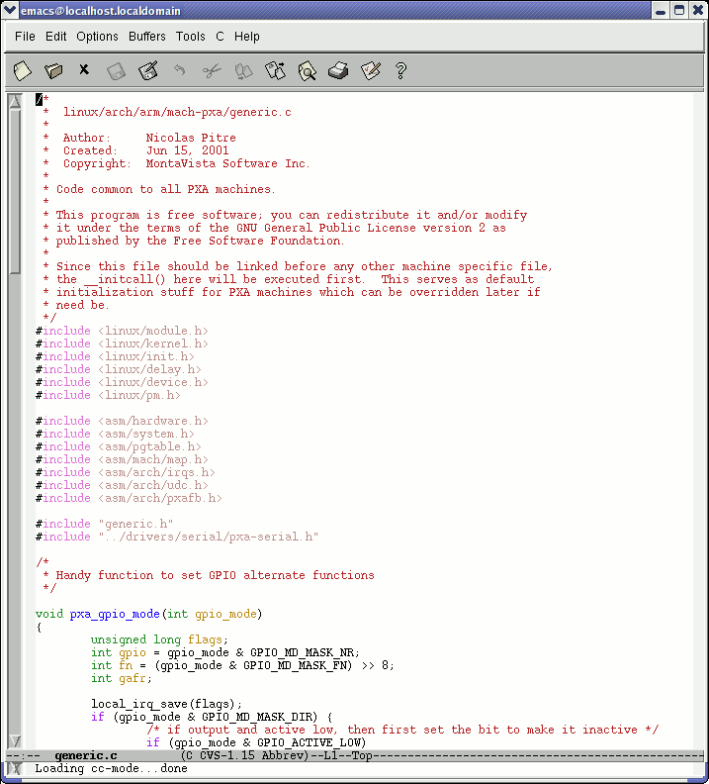
Emacs
Extremely powerful text editor features
Great for power users
Non standard shortcuts
Much more than a text editor (games, e-mail, shell, browser).
Some power commands have to be learnt.

Slide 100
Emacs
$ emacs
Cursor movement
^f (forward one char.)
^b (backward one char.)
^a (begin of line)
^e (end of line)
^n (next line)
^p (prev. line)
^v (page up)
alt-v (page down)
Deletion
^d (delete one char)
alt-d (delete one word)
^k (delete line)
Paste
^y (yank)
Undo
^/
Load file
^x^f
Cancel
^g
Save/Quit
^x^c (quit w/out saving)
^x^s (save)
^x^w (write to a new file)

Slide 101
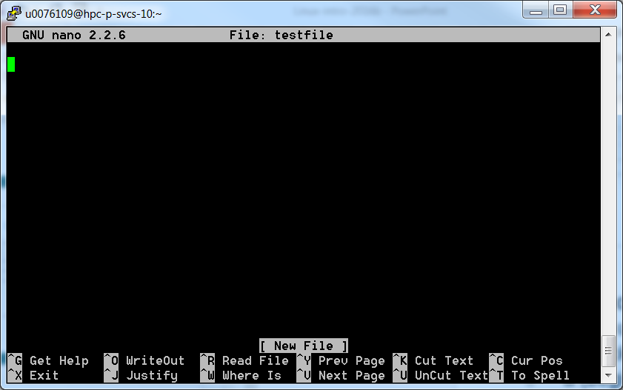
Nano
Exit=Ctrl+X

Slide 102
Displaying file contents
Several ways of displaying the contents of files.
$ cat file1 displays the contents of the given file.
$ cat file1 file2 file3 ... (concatenate) Concatenates and outputs the contents of the given files.
$ more file1 Display the output of a command or text file one page at a time.
Can also jump to the first occurrence of a keyword (/ command).

Slide 103
Displaying file contents
$ less file1 Does more than more. Doesn't read the whole file before starting. Supports backward movement in the file (? command).
Press q to exit
$ display file1
Displays graphical file (simple image)

Slide 104
The head and tail commands
$ head [-<n>] <file> Displays the first <n> lines (or 10 by default) of the given file. Doesn't have to open the whole file to do this!
$ tail [-<n>] <file> Displays the last <n> lines (or 10 by default) of the given file. No need to load the whole file in RAM! Very useful for huge files.
$ tail -f <file> (follow) Displays the last 10 lines of the given file and continues to display new lines when they are appended to the file. Very useful to follow the changes in a log file, for example.

Slide 105
The grep command
$ grep <pattern> <files> Scans the given files and displays the lines which match the given pattern.
$ grep error *.log Displays all the lines containing error in the *.log files
$ grep -i error *.log Same, but case insensitive
$ grep -ri error . Same, but recursively in all the files in the current directory and its subdirectories
$ grep -v info *.log Outputs all the lines in the files except those containing info.
http://www.thegeekstuff.com/2009/03/15-practical-unix-grep-command-examples/

Slide 106
wget
Instead of downloading files from your browser, just copy and paste their URL and download them with wget
main features
http and ftp support
Can resume interrupted downloads
Can download entire sites or at least check for bad links
Very useful in scripts or when no graphics are available (system administration, embedded systems)
$ wget -c http://microsoft.com/customers/dogs/winxp4dogs.zip Continues an interrupted download.
$ wget -r -np http://www.xml.com/ldd/chapter/book/ Recursively downloads an on-line book for off-line access. -np: "no-parent". Only follows links in the current directory.

Slide 107

Hands-on 3

Slide 108
Various commands

Slide 109
time
time a helpful command for doing simple benchmarking
run your scripts along with time command, and compare their’s execution time.
Example: $ time ls real 0m2.304s (actual elapsed time) user 0m0.449s (CPU time running program code) sys 0m0.106s (CPU time running system calls) real = user + sys + waiting waiting = I/O waiting time + idle time (running other tasks)

Slide 110
information about users
$ who Lists all the users logged on the system.
$ whoami Tells what user I am logged as.
$ groups Tells which groups I belong to.

Slide 111
More commands
$ sleep 60 Waits for 60 seconds (doesn't consume system resources).
$ wc report.txt word count Counts the number of lines, words and characters in a file or in standard input.
$ date Returns the current date. Useful in scripts to record when commands started or completed.
Before you run a command, which tells you where it is found $ which ls

Slide 112
Measuring disk usage
$ du -h <file> -h: returns size on disk of the given file, in human readable format: K (kilobytes), M (megabytes) or G (gigabytes), Without -h, du returns the raw number of disk blocks used by the file (hard to read). Note that the -h option only exists in GNU du.
$ du -sh <dir> -s: returns the sum of disk usage of all the files in the given directory.

Slide 113
Measuring disk space
$ df -h <dir> Returns disk usage and free space for the filesystem containing the given directory. Similarly, the -h option only exists in GNU df.
Example: $ df -h . Filesystem Size Used Avail Use% Mounted on /dev/hda5 9.2G 7.1G 1.8G 81% /
$ df -h Returns disk space information for all filesystems available in the system. When errors happen, useful to look for full filesystems.

Slide 114
Comparing files and directories
$ diff file1 file2 Reports the differences between 2 files, or nothing if the files are identical.
$ diff -r dir1/ dir2/ Reports all the differences between files with the same name in the 2 directories.
These differences can be saved in a file using the redirection, and then later re-applied.
https://linuxacademy.com/blog/linux/introduction-using-diff-and-patch/

Slide 115
Other commands
cut – cuts columns of text from a file
echo – displays a line of text
paste – will paste columns of text into a file
sort – sorts a file of lines alfabetically
tr – translates between characters (e.g. tr a-z A-Z)
rpm -q – query about installed software
whereis - locate the binary, source, and manual page files for a command
which - shows the full path of (shell) commands
bc – command line calculator (scale=2 to see 2 digits)

Slide 116
archiving

Slide 117
File Archiving: tar
Saves and restores multiple files to/from a single file. Directories followed recursively.
Format:
$ tar [options] [options_values] [files]
c – create a new archive
v – verbosely list files which are processed.
f – following is the archive file name
z – filter the archive through gzip (compress)
x – extract files from archive
j - filter the archive through bzip (compress)

Slide 118
File Archiving: tar
Examples:
$ tar -cvf [FILE] [ITEM] Backup the specified item(s)
$ tar -cvf /tmp/backup.tar ~/data ~/test
$ tar -czvf [FILE] [ITEM] Compress the archive to save space
$ tar -xvf [FILE] [ITEM] Restore the specified item(s) $tar -xvf backup.tar
$ tar -tf [FILE] List all files in the specified archive
e.g. $ tar -tf backup.tar
http://www.thegeekstuff.com/2010/04/unix-tar-command-examples/

Slide 119
File Compression: gzip
Compressing files: gzip filename or bzip2 filename
$ gzip backup.tar
$ bzip2 backup.tar
The resulted file is backup.tar.gz/ backup.tar.bz2
Uncompressing files: gzip -d filename.gz or bzip2 –d filename.bz2
$ gzip –d backup.tar.gz
$ bzip2 –d backup.tar.bz2
The uncompressed file is backup.tar

Slide 120
Users, groups, security

Slide 121
File access rights
Linux File Access Privilege
Linux is a multiuser system, the files of all users are stored in a single file structure
Mechanism is required to restrict one user to access the files of another user, if he is not supposed to
User can impose access permission to each file to restrict its access
The term “access permission” refers to
read permission
write permission
execute permission

Slide 122
File access rights
3 types of access rights
Read access (r)
reading, opening, viewing, and copying the file is allowed
Write access (w)
writing, changing, deleting, and saving the file is allowed
Execute rights (x)
executing and invoking the file is allowed. This is required for directories to allow searching and access.
Use ls -l to check file access rights

Slide 123
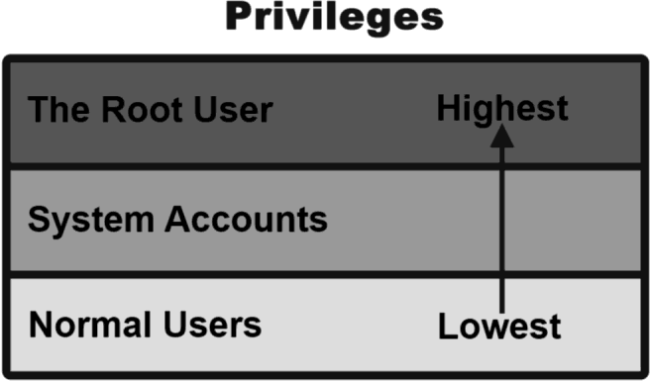
File access rights
3 types of access levels
User (u): for the owner of the file
Group (g): each file also has a “group” attribute, corresponding to a given list of users
Others (o): for all other users

Slide 124
File access rights
File last modified date
Hard link no
Owner’s group
Owner
d rwx r-x r-x 2 dlun dlun 4096 May 17 2001 Autostart
It is a directory
file size
file name
The directory can be read, written and executed by the user dlun
The directory can be read and executed but not written by other users in the same group of dlun
The directory can be read and executed but not written by other users in different group of dlun
The group of a user is assigned by the administrator when a user is added to the system

Slide 125
File access rights
Access permission can also be assigned to a directory
Directory is also a file that contains the attributes of the files inside it
If read permission is not given to a directory
cannot show the structure of this directory
e.g. cannot use ls
If write permission is not given to a directory
cannot modify anything of the directory structure
e.g. cannot copy a file into this directory since it will modify the directory structure by adding one more file
If execute permission is not given to a directory
nearly nothing can be done with this directory, even cd

Slide 126
Access rights examples
-rw-r--r-- Readable and writable for file owner, only readable for others
-rw-r----- Readable and writable for file owner, only readable for users belonging to the file group.
drwx------ Directory only accessible by its owner
-------r-x File executable by others but neither by your friends nor by yourself. Nice protections for a trap...

Slide 127
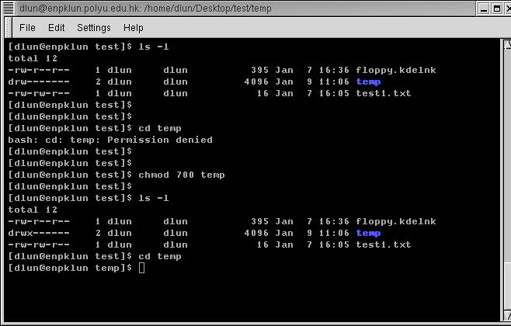
Access rights examples
temp does not have execution right
even cd is not workable
execution right is added
now we can change the directory to temp

Slide 128
chmod: changing permissions
Permissions allow you to share files or directories or to lock them down to be private.
$ chmod (change mode)
$ chmod <permissions> <files> 2 formats for permissions:
octal format (3 digit octal form)
symbolic format

Slide 129
chmod: changing permissions
octal format (abc): a,b,c = r*4+w*2+x*1 (r, w, x: booleans)
0 none ---
1 execute-only --x
2 write -w-
3 execute and write -wx
4 read-only r–
5 read and execute r-x
6 read and write rw-
7 read, write, and execute rwx
$ chmod 644 <file> (rw for u, r for g and o)
660 : 110 110 000
⇒ rw- rw- ---
545 : 101 100 101
⇒ r-x r-- r-x

Slide 130
chmod: changing permissions
symbolic format: $ chmod go+r: add read permissions to group and others. $ chmod u-w: remove write permissions from user. $ chmod a-x: (a: all) remove execute permission from all.

Slide 131
Access right constraints
x is sufficient to execute binaries Both x and r and required for shell scripts.
Both r and x permissions needed in practice for directories: r to list the contents, x to access the contents.
You can't rename, remove, copy files in a directory if you don't have w access to this directory.
If you have w access to a directory, you can remove a file even if you don't have write access to this file (remember that a directory is just a file describing a list of files). This even lets you modify (remove + recreate) a file even without w access to it.

Slide 132
process control

Slide 133
Process
“Everything in Unix is a file. Everything in Unix that is not a file is a process”
Processes
Instances of a running programs
Several instances of the same program can run at the same time
Processes are assigned a unique identifier which is used to monitor and control the process (PID)

Slide 134
Process
A program that is claimed to be executing is called a process
For a multitasking system, a process has at least the following three states:
Start execution
Ready
Running
Finish execution
Sleeping

Slide 135
Process
Ready state
All processes that are ready to execute but without the CPU are at the ready state
If there is only 1 CPU in the system, all processes except one are at the ready state
Running state
The process that actually possesses the CPU is at the running state
If there is only 1 CPU in the system, at most there is only one process is at the running state
Sleeping state
The process that is waiting for other resources, e.g. I/O, is at the sleeping state

Slide 136
ps
Display running processes (cfr. Windows Task Manager ctrl-shift-esc)
$ ps Display the current user's processes
$ ps -e Display all processes running on the system
$ ps -ef Display detailed information about running processes
$ ps -u [USER] Display processes owned by the specified user
$ ps a Display extra info (running state)

Slide 137
Process
PID TTY STAT TIME COMMAND
14748 pts/1 S 0:00 –bash
pts/0 S 0:00 –bash
14974 pts/0 S 0:00 vi test1.txt
14876 pts/1 R 0:00 ps …
How much time the process is continuously executing
State:
S – Sleeping
(waiting for input)
R – Running
Process ID
Terminal name
For the example above, both bash processes, which are the shell of both terminals, are waiting for the input of user. They must be in the sleeping state
The vi process, which is an editor, is also waiting for the input of user. Hence it is also in sleeping state
When ps reporting the processes in the system, it is the only process that is running. Hence it is in running state

Slide 138
kill
Sends an abort signal to the given processes. Lets processes save data and exit by themselves. Should be used first.
$ kill <pid> Example: $ kill 3039 3134 3190 3416
$ kill -9 <pid> Sends an immediate termination signal. The system itself terminates the processes. Useful when a process is really stuck.

Slide 139
killall
The killall command terminates all processes that match the specified name
$ killall [-<signal>] <command> Example: $ killall bash

Slide 140
xkill
xkill Lets you kill a graphical application by clicking on it! Very quick! Convenient when you don't know the application command name.

Slide 141
&
& is a command line operator that instructs the shell to start the specified program in the background.
This allows you to have more than one program running at the same time without having to start multiple terminal sessions.
Starting a process in background: add & at the end of your line: $ gedit & check with ps

Slide 142
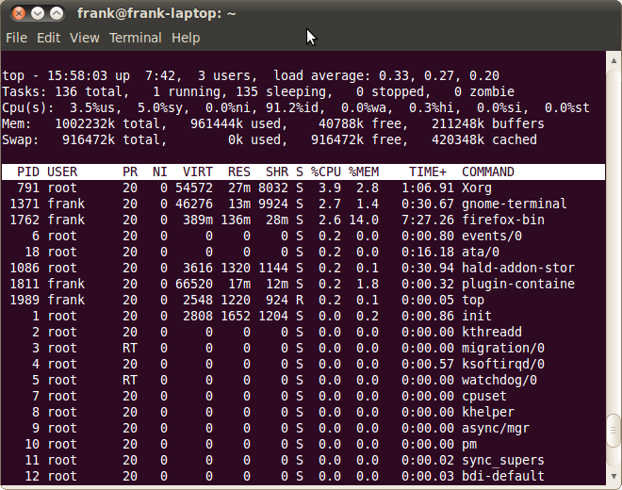
top
Displays most important processes, sorted by cpu percentage (use > or < to change the order)
http://www.thegeekstuff.com/2010/01/15-practical-unix-linux-top-command-examples/

Slide 143
VSC training 2019/2020
Info sessions:
Containers
Notebooks
Matlab
Linux scripting
Introductory
Intermediate
Advanced
Specialist track
Linux for HPC
Linux
HPC intro
worker/atools
Linux tools
Make intro
Version control with Git
Python as a second language
Python: System programming
Scientific Python
Software engineering
Python for data science
C
C++ for scientific computing
Fortran for programmers
Python for HPC
OpenMP
Debugging techniques
MPI
Code optimization
?
Stay up-to-date https://www.vscentrum.be/training

Slide 144
Handout

Slide 145
List of basic commands
Managing files and directories:
cp, mv, rm, mkdir, rmdir, touch
Displaying content of files
cat, more, less, head, tail
Moving around
pwd, cd, ls
Asking for help
help, man, info, whatis
+ understanding of Linux directory tree (relative and absolute paths)
+ understanding of file permissions

Slide 146
Hands-on 4

